Slide 1
GrizzBank
Adam Komeshak, Evan Sketch, Mike Moore
Notes:
Everyone

Slide 2

Application scenario and problem statement
A web application for clients to manage their checkings & savings accounts within a Bank Management System
A database system is essential because it will update the balance given withdraw, deposit, and transfers of fees
In addition, our app will store login information for each enrolled client
Notes:
EVAN

Slide 3
Functional requirements
Login:
Inputs:
Account Username, password
Outputs:
Success: Redirect to user’s bank account home page with accounts registered on the screen
Failure: Remain on login page, and report password or email incorrect
Database Interactions:
Access the CLIENT table, and see if a client exists for the account Username entered.
Notes:
ADAM

Slide 4
Functional requirements
Transfer money:
Inputs:
Transfer Amount, Originating Account, and Destination Account
Outputs:
Success: Redirect to success page, w/ update account balances for Origin/Destination accounts
Failure: Redirect to failure page, showing neither account balance chanced, and explain why transfer failed
Database Interactions:
Tables accessed: ACCOUNT, CLIENT. The origin account balance should be reduced by the transfer amount The destination account balance should be increased by the transfer
Notes:
MIKE
In: Account to transfer from, account to transfer to.
Out:

Slide 5
Functional requirements
Change password:
Input:
Given user is logged in, request a password change. After verification of original password they would input their new password.
Output:
The password would be changed and would be redirected to the index page new password updated in database or if not confirmed will not change password
Database Interaction:
Would search the CLIENT table for the username/email that they are logged into and go into the CLIENT table to verify their password was correct and then go back into the CLIENT table to change the password hash/salt that they changed.
Notes:
ADAM

Slide 6
Functional requirements
Forgot password:
Input:
The user forgot their password and would input their username, get a confirmation email, then input new password
Output:
User would obtain new password to be able to log into their account or if failed will be returned to the login page without password being reset
Database interaction:
It would search the CLIENT table for the email that was given and after sending a verification email and entering the code then the password would be changed in the CLIENT table along with its hash and salt that is assigned to that account. Also interacts with REQUEST RESET table to store verification code and expiration time.
Notes:
ADAM

Slide 7
Functional requirements
Create Account:
Input:
The user wants to create an account. In order to do so, the user inputs their first name and last name, email, username, phone number, password, account balance.
Output:
User would obtain a new account. If a user inputs a negative balance, duplicate username, email, or phone number, then the screen gives an error message popup.
Database interaction:
The data inputted by the user would populate the CLIENT, USERNAME_ARCHIVE, EMAIL_ARCHIVE, PHONE_NUMBER_ARCHIVE, and ACCOUNT tables respectively.
Notes:
EVAN

Slide 8
Functional requirements
Deposit:
Input:
Desired deposit amount in terms of $, account type and number
Output: Redirect user to the the home page reporting deposit success, or remain on deposit page if input is invalid
Database Interaction:
CLIENT Table queried to determine accounts associated with the client
Balance field of destination account row in ACCOUNT table increased by deposit amount
Notes:
MIKE

Slide 9
Functional requirements
Delete Savings/Checking:
Input:
The user wants to delete one of their checking/savings accounts. The user has at least 2 accounts open (checking or savings).
User has confirmed their desire to delete the account
Output:
The account to be deleted is deleted, and its balance is transferred to the destination account, redirecting to the home page with a success message.
Database interactions:
The account selected to transfer remaining balance into has its balance increased by the amount currently in the account to delete.
The deleted account is removed from the ACCOUNT table.
Notes:
MIKE
Input: user has clicked the delete account link from the nav bar and has at least two accounts (Checking or Savings). USer must confit their desire to delete, then select the account to delete and a destination for remaining balance.
Output: The account to delete has been removed from ACCOUNT, and the destination account balance is increased by the balance which the deleted account had.

Slide 10
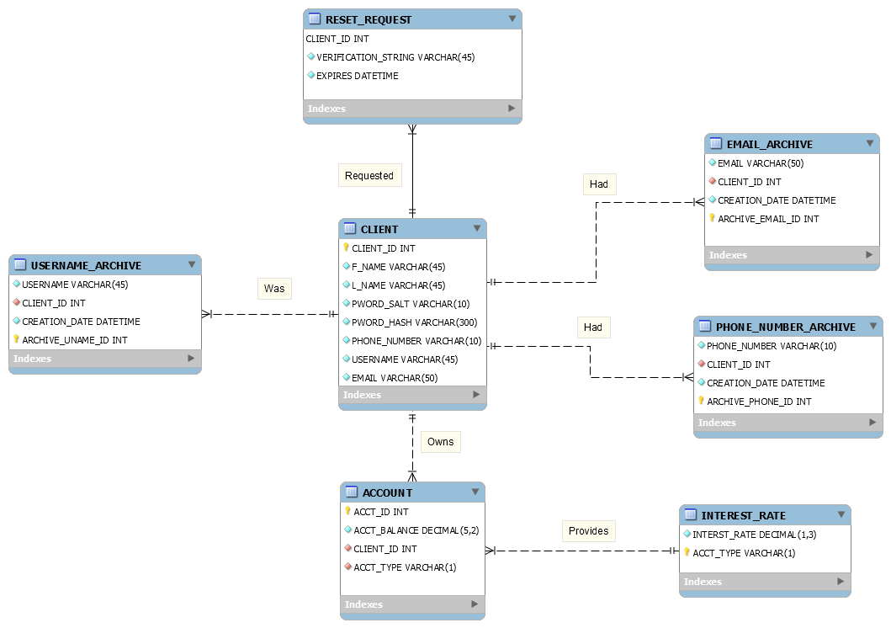
ER-diagram
Notes:
EVAN

Slide 11
Tools,frameworks,and technologies used for implementation
Apps - Django, MySQL, MySQLServer
Languages - SQL, CSS, HTML, Python
Tools - Pipenv

Slide 12

End of presentation!
Now onto the demo

Slide 13
Demo *for presenter use to see demo requirements*
The demo should be done in the remaining 10 minutes addressing:
o A walkthrough of your project setup and different components like front-end, back-end,
database etc.
o A demo of 5 unique category of operations that will specifically require access to the
database (The following five operations are mandatory)
Create new entries - Create Account
Read existing entries - Home page viewing
Update existing entries - Transfer
Delete existing entries - Delete
Search entries or perform user authentication (user validation through log-in
operations) - Login

